Slide 1
HimawariCast
Practical Training
Japan Meteorological Agency

Slide 2
Goal of this training
Effective Use of Himawari data
  How can we use the data?
  What kind of things can we do using the data?
Learn SATAID!
  What can we do using SATAID?
  Do exercise to deepen the understanding

Slide 3
Contents
Preparation
Introduction to SATAID
Basic Functions of SATAID
Exercise using SATAID
  Cloud Analysis
  Detect Various Phenomenon

Slide 4
Curriculum (Viet Nam)
 | 08:30 – 11:30 | 13:30 – 15:00 | 15:00 – 17:00
10th Dec. (Thurs.) |  | Opening Overview of Himawari-8/9 Utilization of SATAID | Basics of meteorological satellite and satellite analysis
11th Dec. (Fri.) | Utilization of newly equipped bands on Himawari-8 including practical training | Practical training on utilization of RGB composite & High resolution Cloud Analysis Information HCAI) & Heavy Rainfall Potential Areas | Analysis training 1
12th Dec. (Sat.) | Utilization of satellite data for weather forecast and disaster risk reduction Analysis training 2
TANAKA OKUYAMA NISHIMURA

Slide 5
Open the folder
Preparation
Please copy “HimawariCast_Training” folder in the USB memory to the “C Drive”
Open “HimawariCast_Training” folder

Slide 6
Preparation
Folder structure
\HimawariCast_Training
\GMSLPD
\TANAKA
\Manual
\OKUYAMA
\OTHER
\PPT
\SATAID_DATA

Slide 7
Install SATAID program
Preparation
Open “Gmslpd” folder
Double-click “Gsetup.exe”
If OS type of your PC is 64 bit windows, open “Gsetup64.exe”

Slide 8
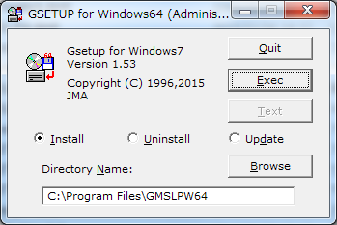
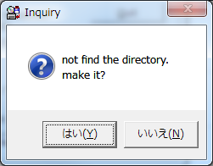
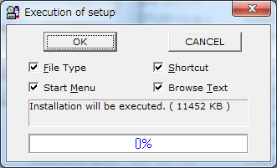
Select
‘Exec’
Select
‘OK’
Select
‘Yes’

Slide 9
Start SATAID
Preparation
Go back to the “HimawariCast Training”
Open “SATAID_DATA” folder
Open “201508” folder
Double-click “20150803.ATC”

Slide 10
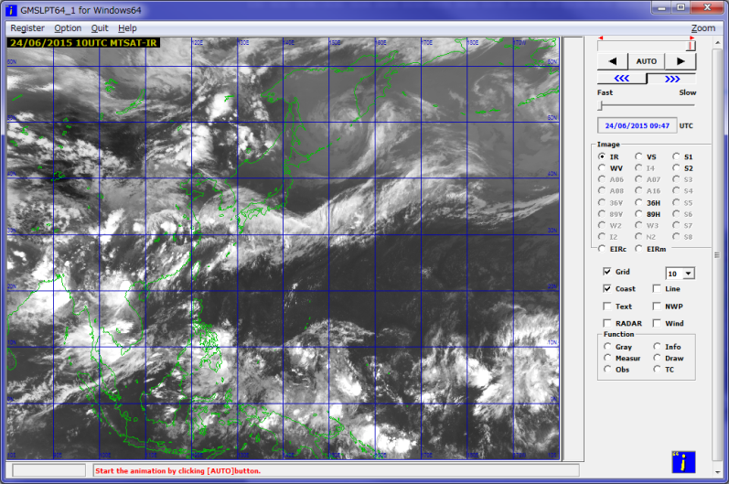
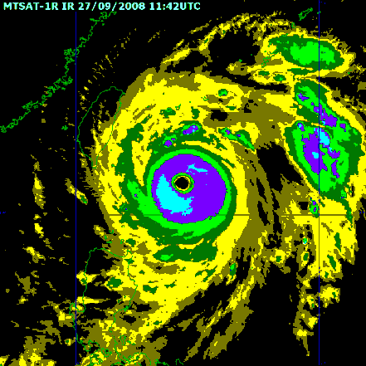
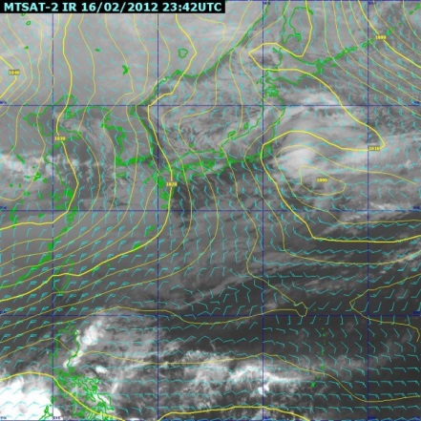
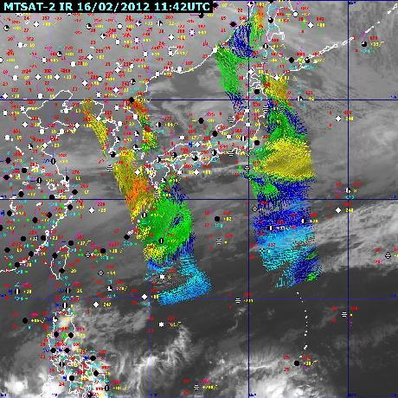
What is SATAID?
Introduction
SATAID (SATellite Animation and Interactive Diagnosis) is a sophisticated display software visualizing meteorological information in multiple dimensions (spatial and temporal), which assists forecasters to analyze and monitor continually weather parameters and phenomena for better meteorological services.
Data overlay
Multiple functions
Animation
Customize display
With NWP data
With observation data
More efficiently
and accurately!

Slide 11
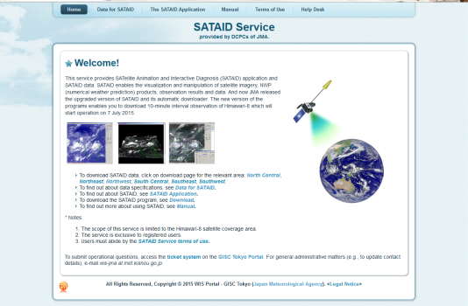
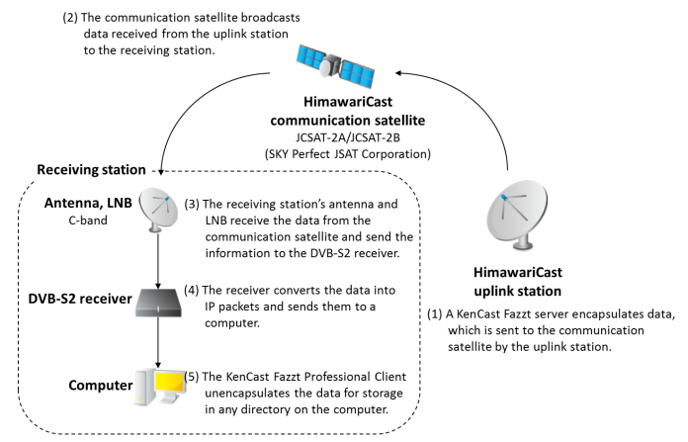
How do we get it?
WIS Website
Himawari-Cast
http://www.wis-jma.go.jp/cms/sataid/
  You need Internet Environment
  You need to get ID and Password
  (wis-jma at met.kishou.go.jp)
  5 channels are available every 10 minutes
http://www.data.jma.go.jp/mscweb/en/himawari89/himawari_cast/himawari_cast.html
  You need dedicated antenna and computers
  14 channels are available every 10 minutes

Slide 12
Data for Exercise
16 Channels
Every-10-minute images
Spatial resolution: 4km in this training
  Original Data is 2km for IR and 1km for VS

Slide 13
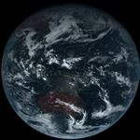
16 Bands of AHI
(Advanced Himawari Imager)
13
True Color Image
MTSAT
Channels
Band |  |  | Wavelength [µm] | Spatial Resolution
1 | V1 | Visible | 0.46 | 1Km
2 | V2 |  | 0.51 | 1Km
3 | VS |  | 0.64 | 0.5Km
4 | N1 | Near Infrared | 0.86 | 1Km
5 | N2 |  | 1.6 | 2Km
6 | N3 |  | 2.3 | 2Km
7 | I4 | Infrared | 3.9 | 2Km
8 | WV |  | 6.2 | 2Km
9 | W2 |  | 7.0 | 2Km
10 | W3 |  | 7.3 | 2Km
11 | MI |  | 8.6 | 2Km
12 | O3 |  | 9.6 | 2Km
13 | IR |  | 10.4 | 2Km
14 | L2 |  | 11.2 | 2Km
15 | I2 |  | 12.3 | 2Km
16 | CO |  | 13.3 | 2Km
RGB band
Composited
VIS
Aerosol
Water cloud and Ice cloud
Size of the cloud droplet
IR4
Fog , Hot spot(Forest fire)
IR3(WV)
Water vapor
SO₂(Sulfur dioxide)
O₃(Ozone)
IR1
IR2
Atmospheric Windows
CO₂(Carbon dioxide)

Slide 14
Introduction to SATAID
Please look at the ‘Quick-Guide’
\HimawariCast Training\PPT\1_[QUICK-GUIDE]SATAIDforHimawariCast.pptx

